Slide 1
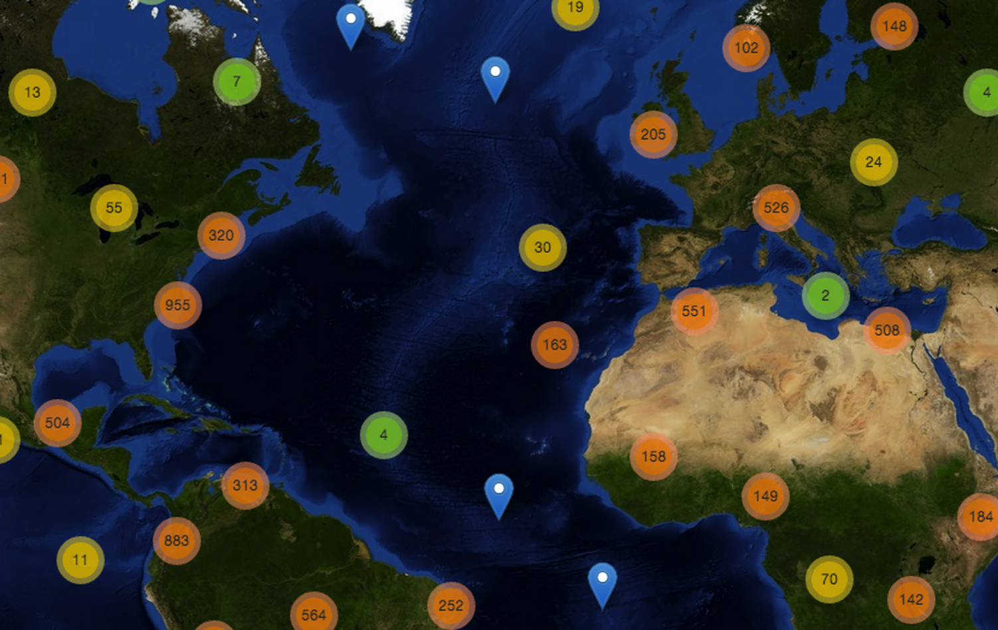
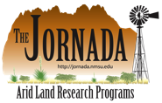


Jason Karl, Ph.D.
USDA ARS, Jornada Experimental Range

Slide 2
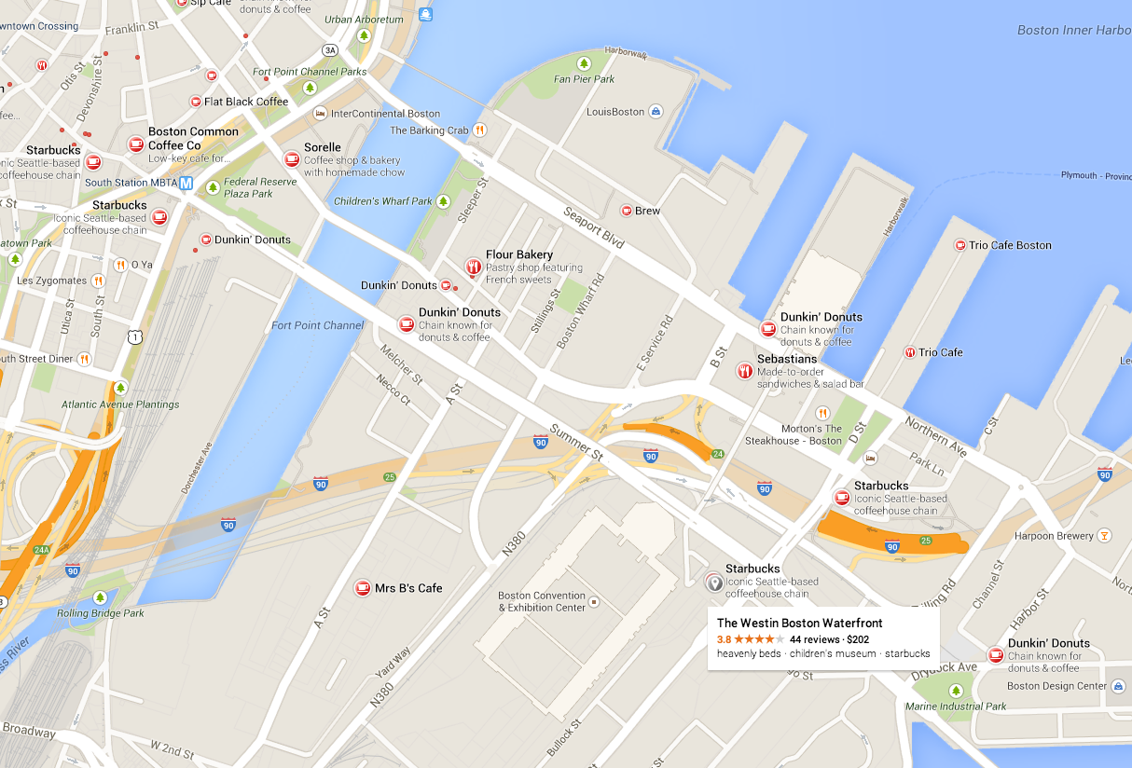
“Siri … Find me a coffee shop in Boston by the Westin Waterfront.”
“I found 18 coffee shops near you.”
Notes:
Finding what we’re looking for has become easy. When I come someplace new I can just pick up my phone and ask Siri or Google where a coffee shop is. And I get a map of all the coffee shops nearby and directions to each one.

Slide 3
Why can’t we find
scientific research by location
just as easily?
Notes:
With just my phone I can find almost any coffee shop in the world on a map in a matter of seconds and be guided right to their door. Why can't we search for scientific literature by location the same way? That was the basic question that drove us to create JournalMap.

Slide 4
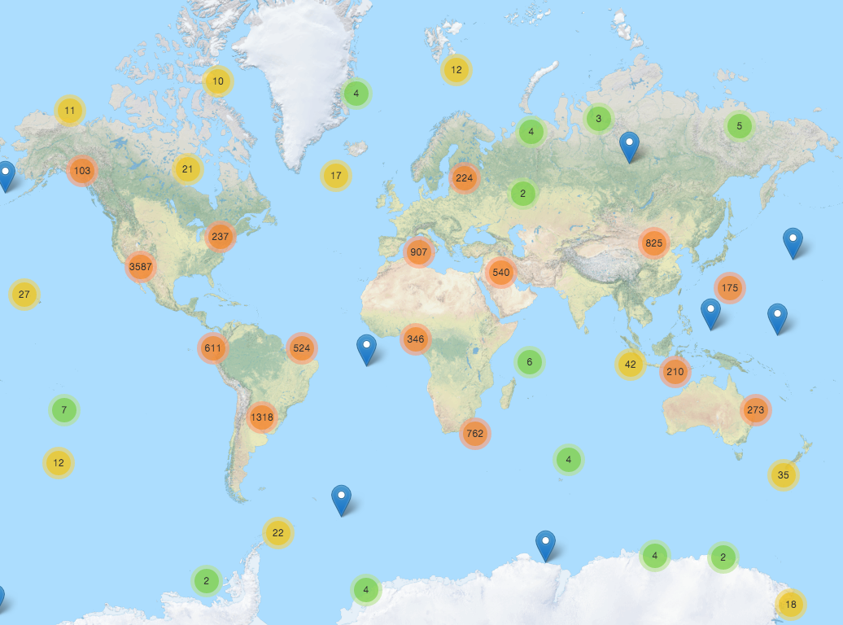
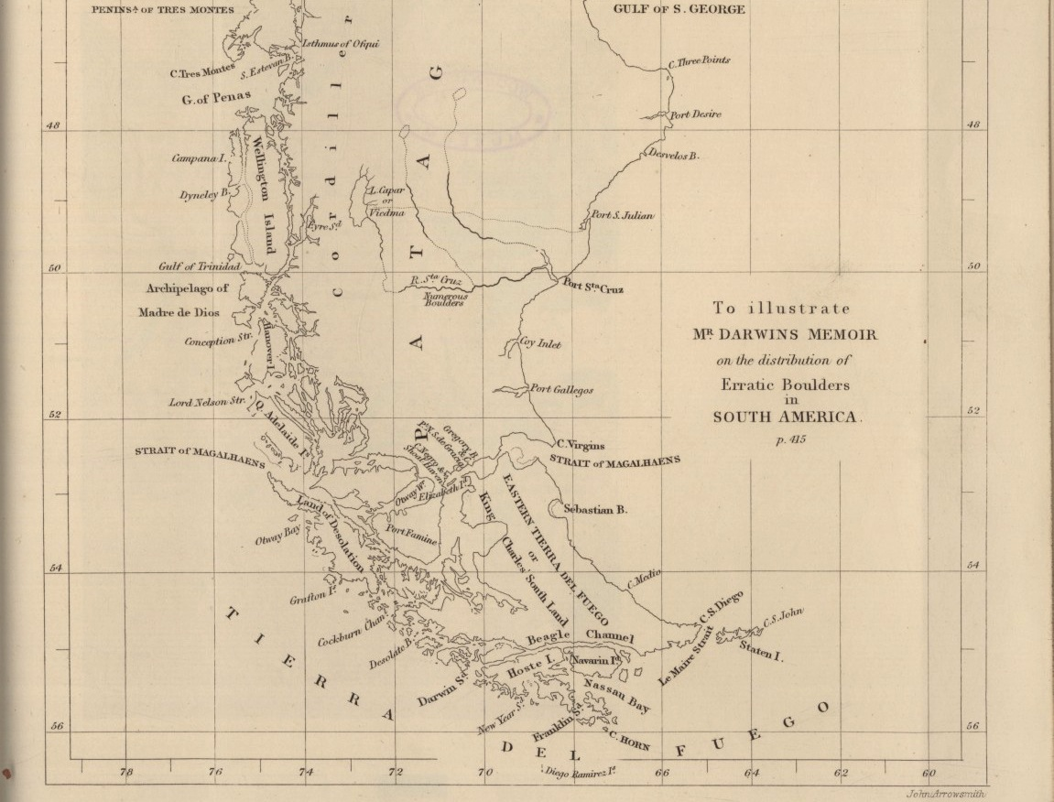
GPS for Research Discovery
Map-based literature search for researchers,
guiding them to your publications
Notes:
Maps are a powerful way to tell stories and have long been a crucial part of scientific publishing. They inform us about things and show relationships better than words alone can. JournalMap extends this idea by plotting on a map where research was done – it’s like GPS for research discovery.

Slide 5
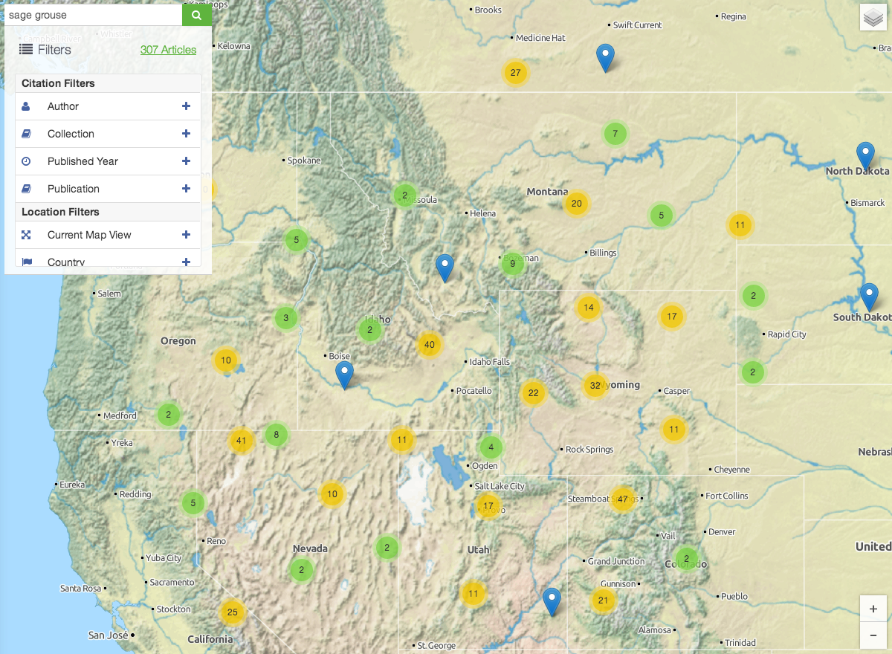
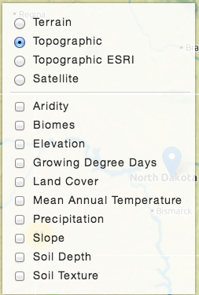
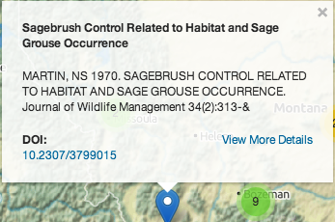
Study Locations are Mapped
(not author affiliations)
Notes:
JournalMap is a free and open web-based search platform for finding scientific literature. Articles are mapped to their locations & you can use filters and keywords to narrow results. Additional map layers can be used to add clarity & context.

Slide 6
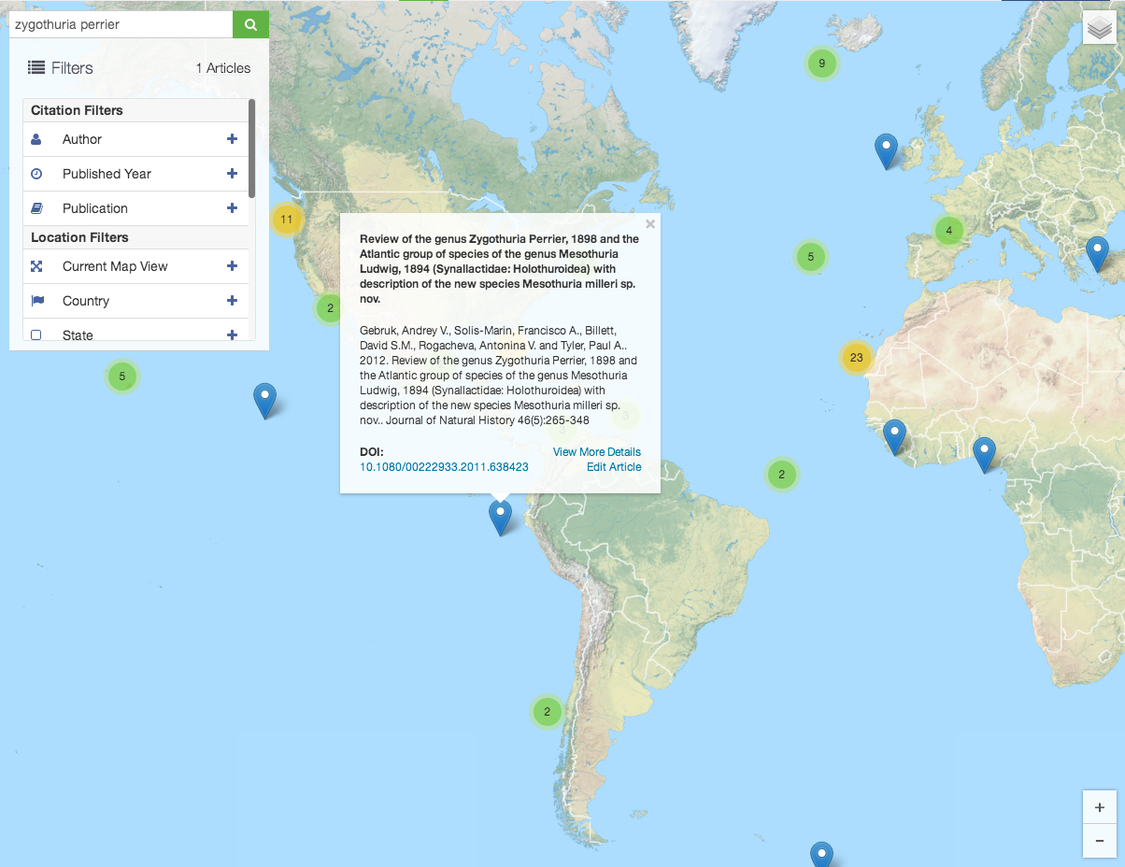
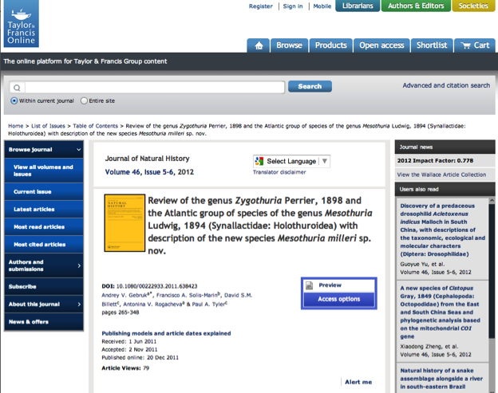
Notes:
With JournalMap I can quickly find articles on a topic that match my needs, visualize their geographic extent, view a quick description of a particular one, read the abstract & go straight to the publisher's website for the full content.

Slide 7
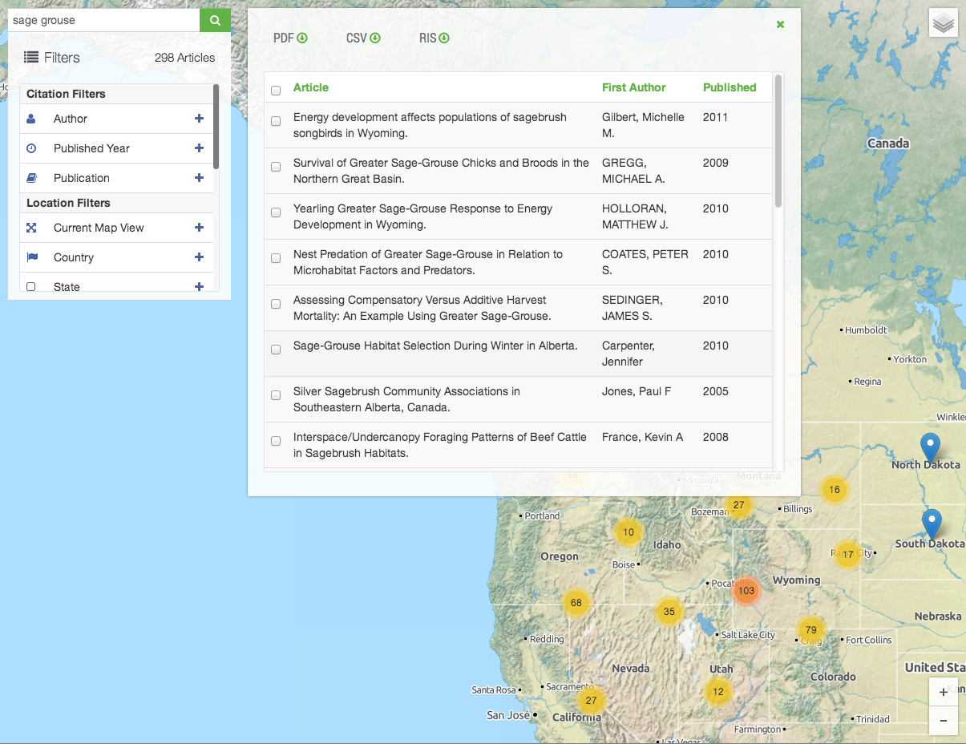
Search results are exportable
(PDF, CSV or RIS files)
Notes:
Here's a topical search for Sage Grouse, a species in the US that has been proposed for listing as threatened. This search retuned a map of almost 300 articles. In addition to the map, we get a full list of the results & can download that list in a number of different formats.

Slide 8
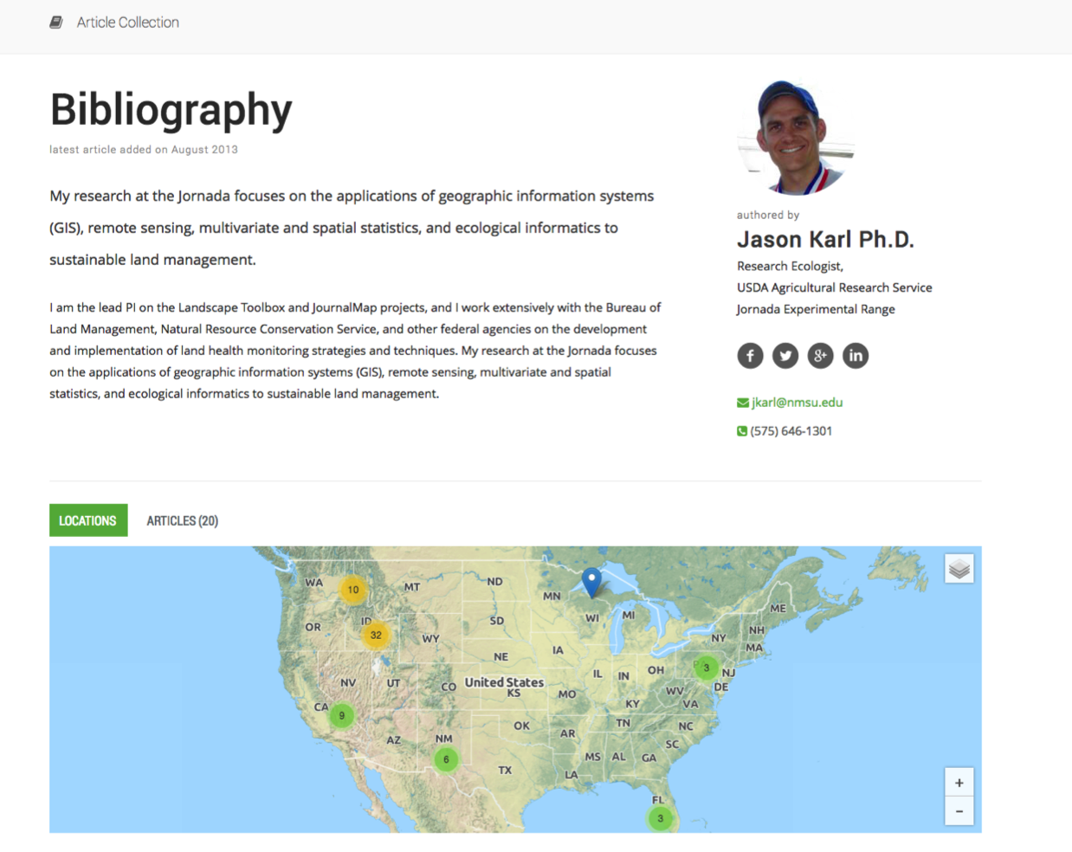
My Spatial Ecology Articles
User-curated collections
with unique URLs
Notes:
With JournalMap we can also create collections of articles or georeferenced bibliographies with static URLs like this example for some of my papers. But JournalMap is more than just map-based searches. There is real analytic power in article mapping.

Slide 9
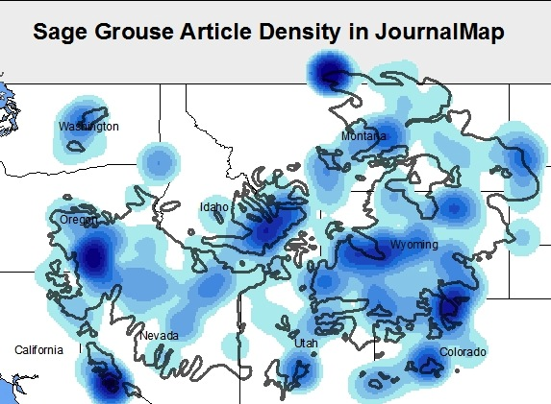
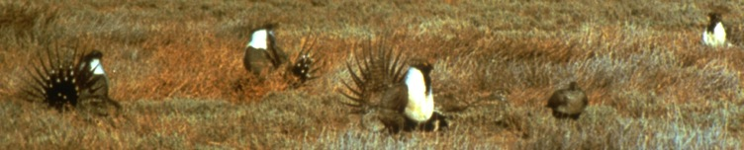
Knowledge hot and cold spots for any topic.
Notes:
Take our sage grouse example from earlier. A comprehensive literature map lets us analyze knowledge hot spots & cold spots relative to where Sage Grouse live. This could help direct research & inform conservation efforts for the species.

Slide 10
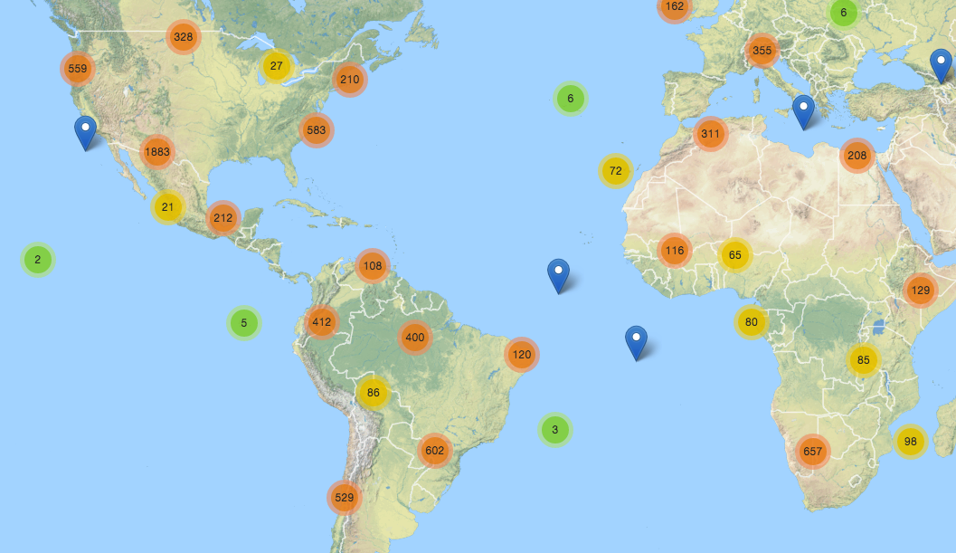
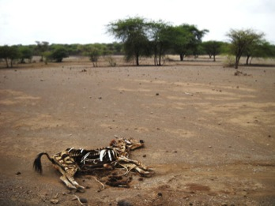
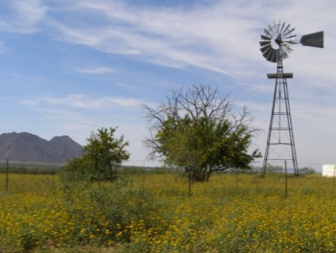
Unsustainable Land Use
Sustainable Land Use
Knowledge Transfer
(Similar Climate & Soils)
Notes:
For knowledge to be transferable, it must have come from someplace with a similar context. With JournalMap we can define environmental similarity based on things like soils and climate in order to find knowledge from research rich areas and apply it to research poor areas for topics like sustainable agriculture.

Slide 11
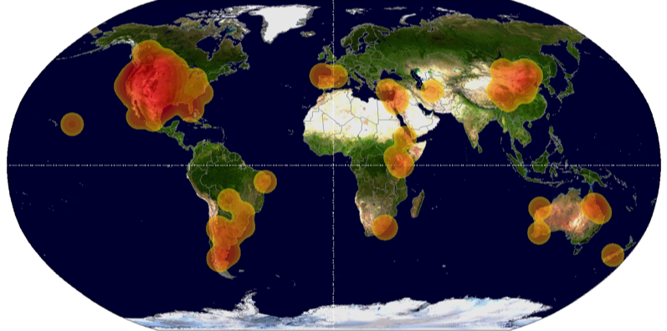
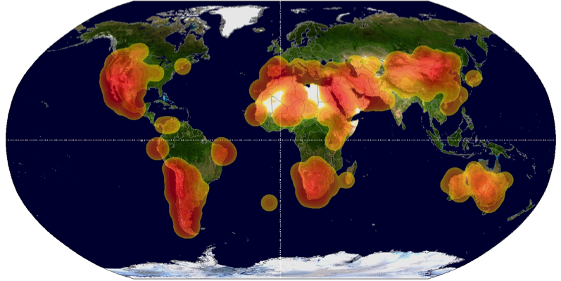
All Articles from Two Journals (2000 to 2012)
Rangeland Ecology
& Management
Journal of Arid Environments
Visualize knowledge distribution, gaps and biases.
Notes:
And what about comparing the distribution of studies from entire journals to look for knowledge gaps or potential biases like in this example of two journals with very similar scopes but different geographic distributions?

Slide 12
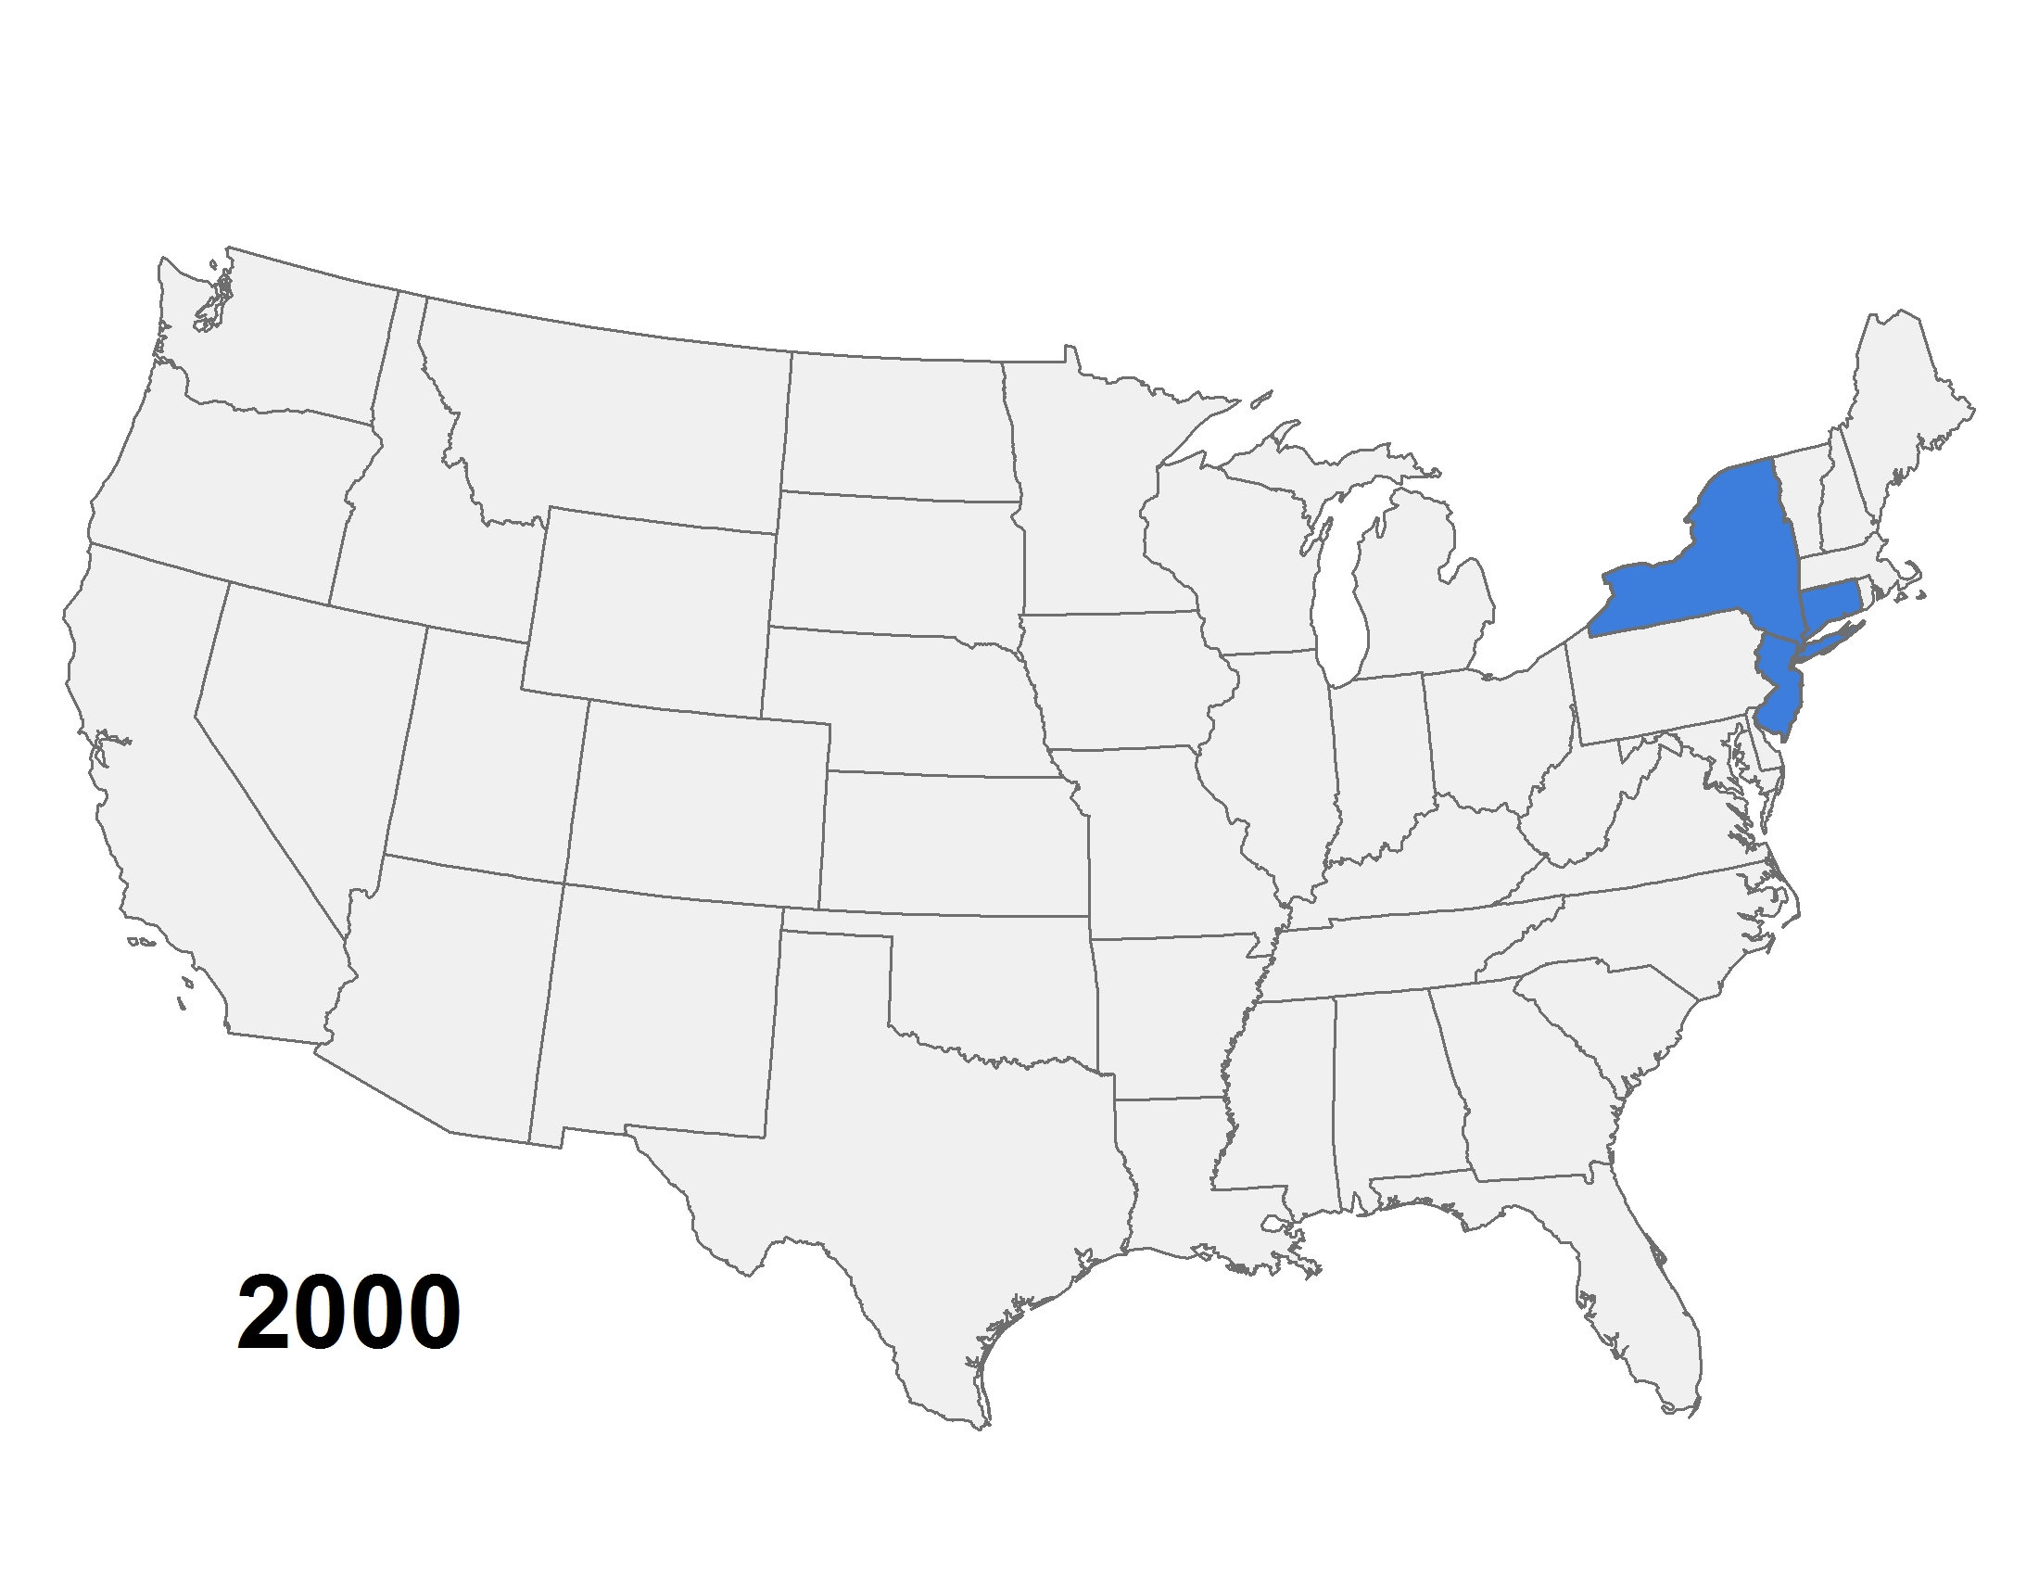
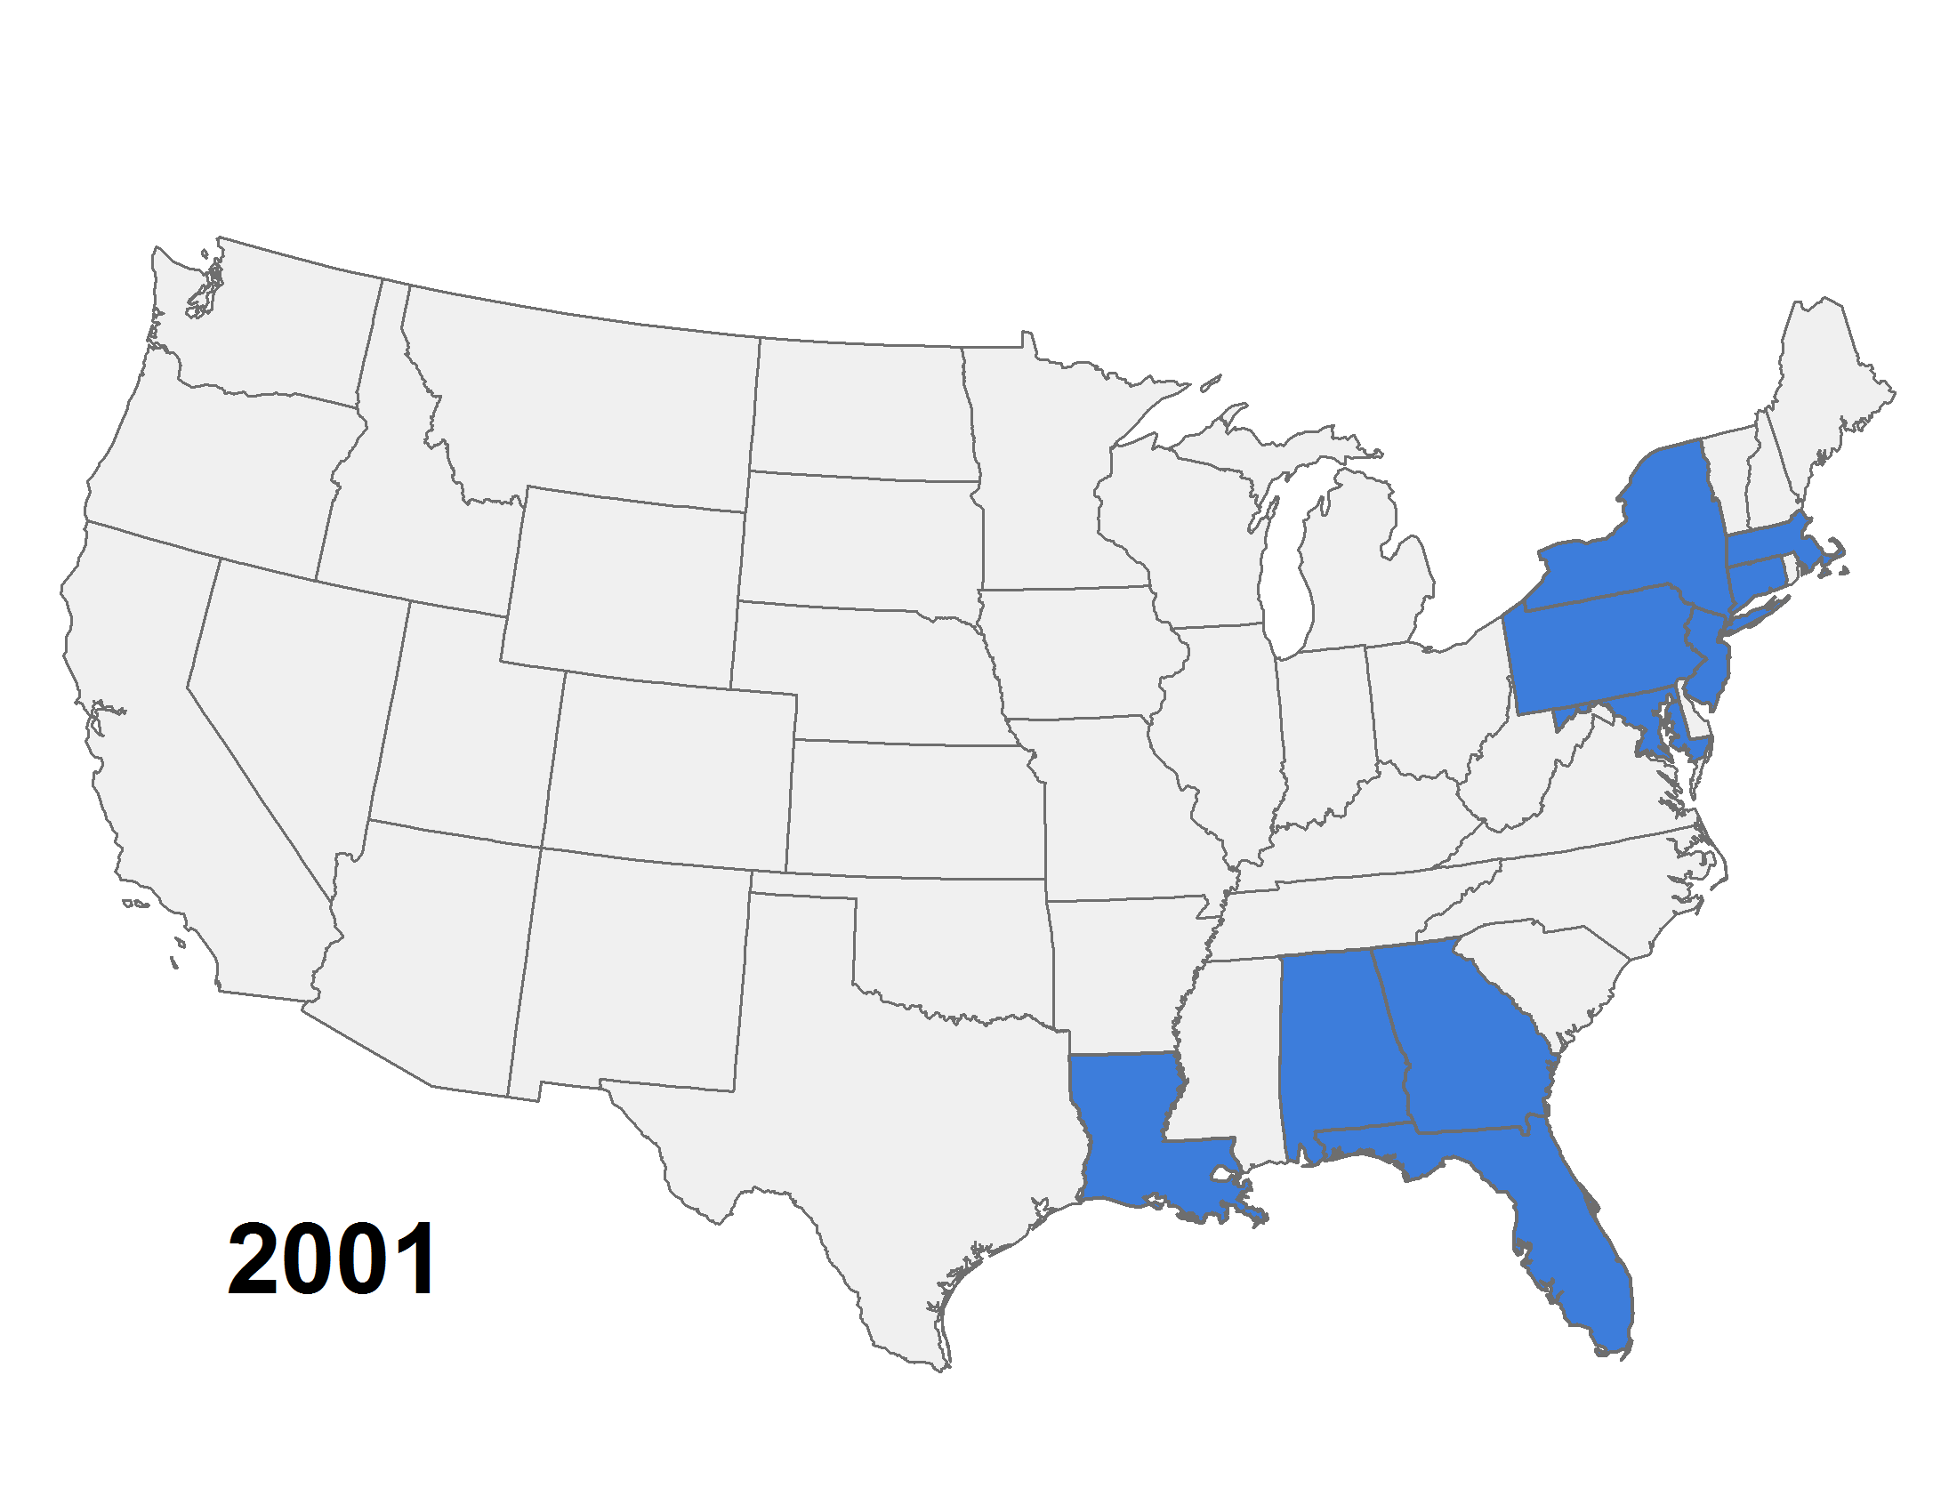
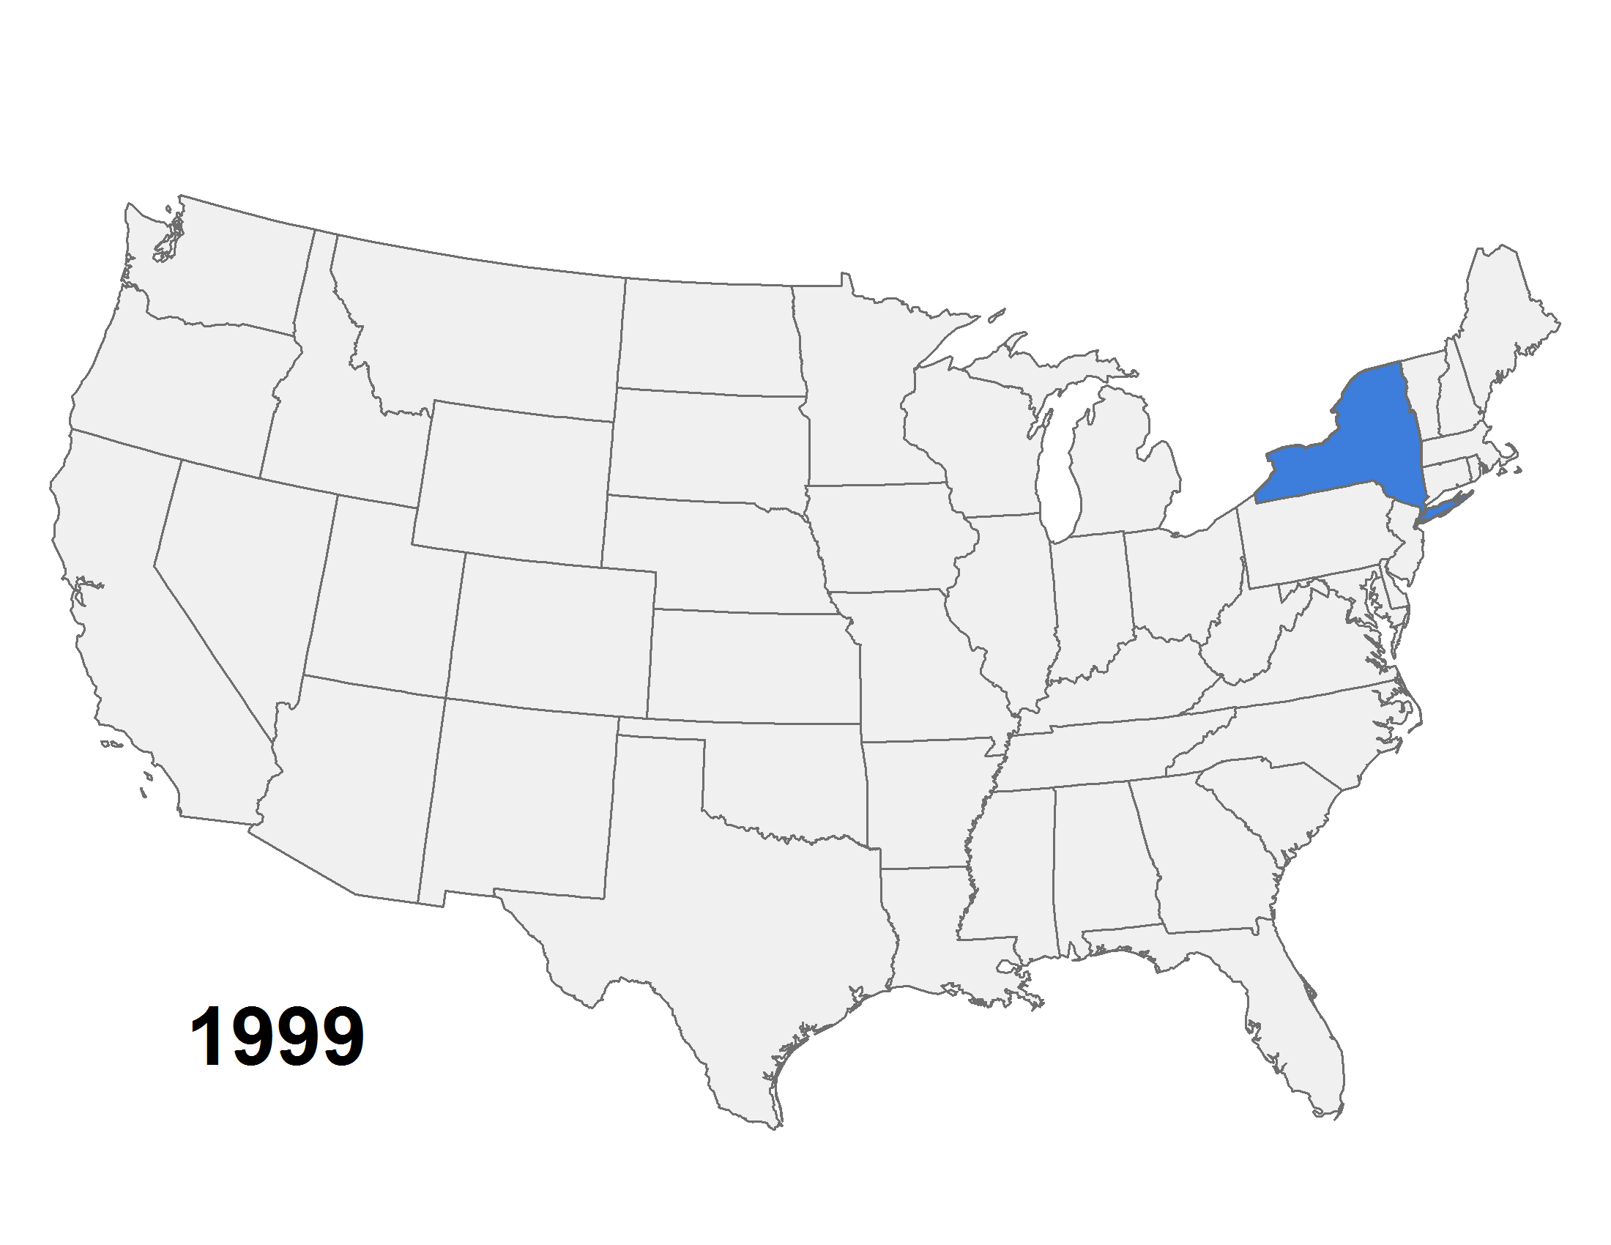
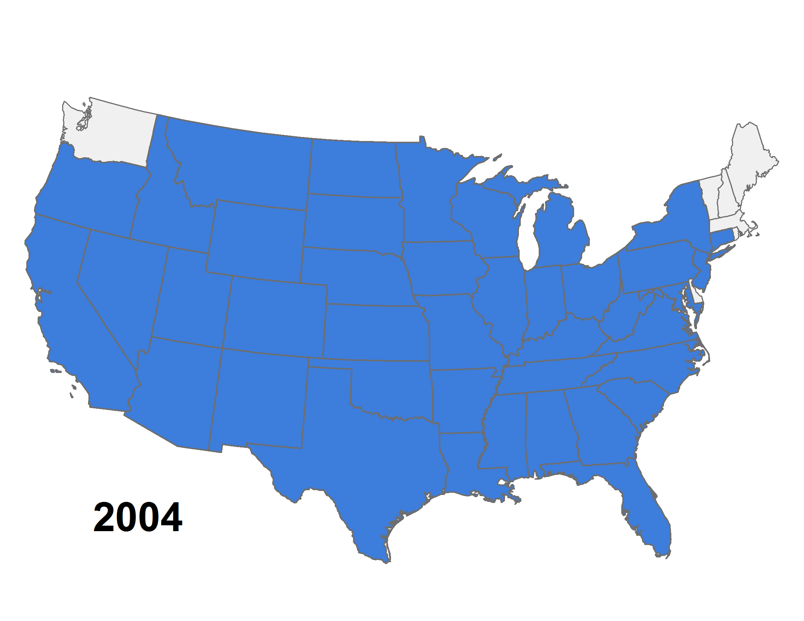
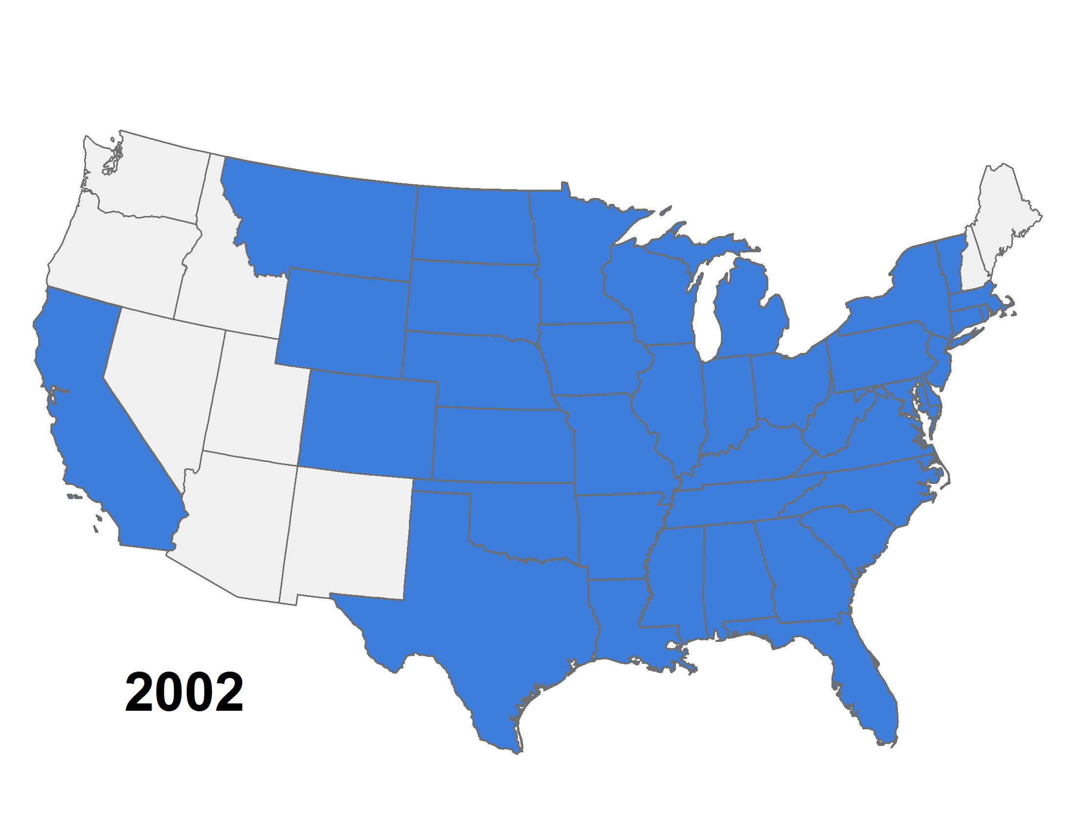
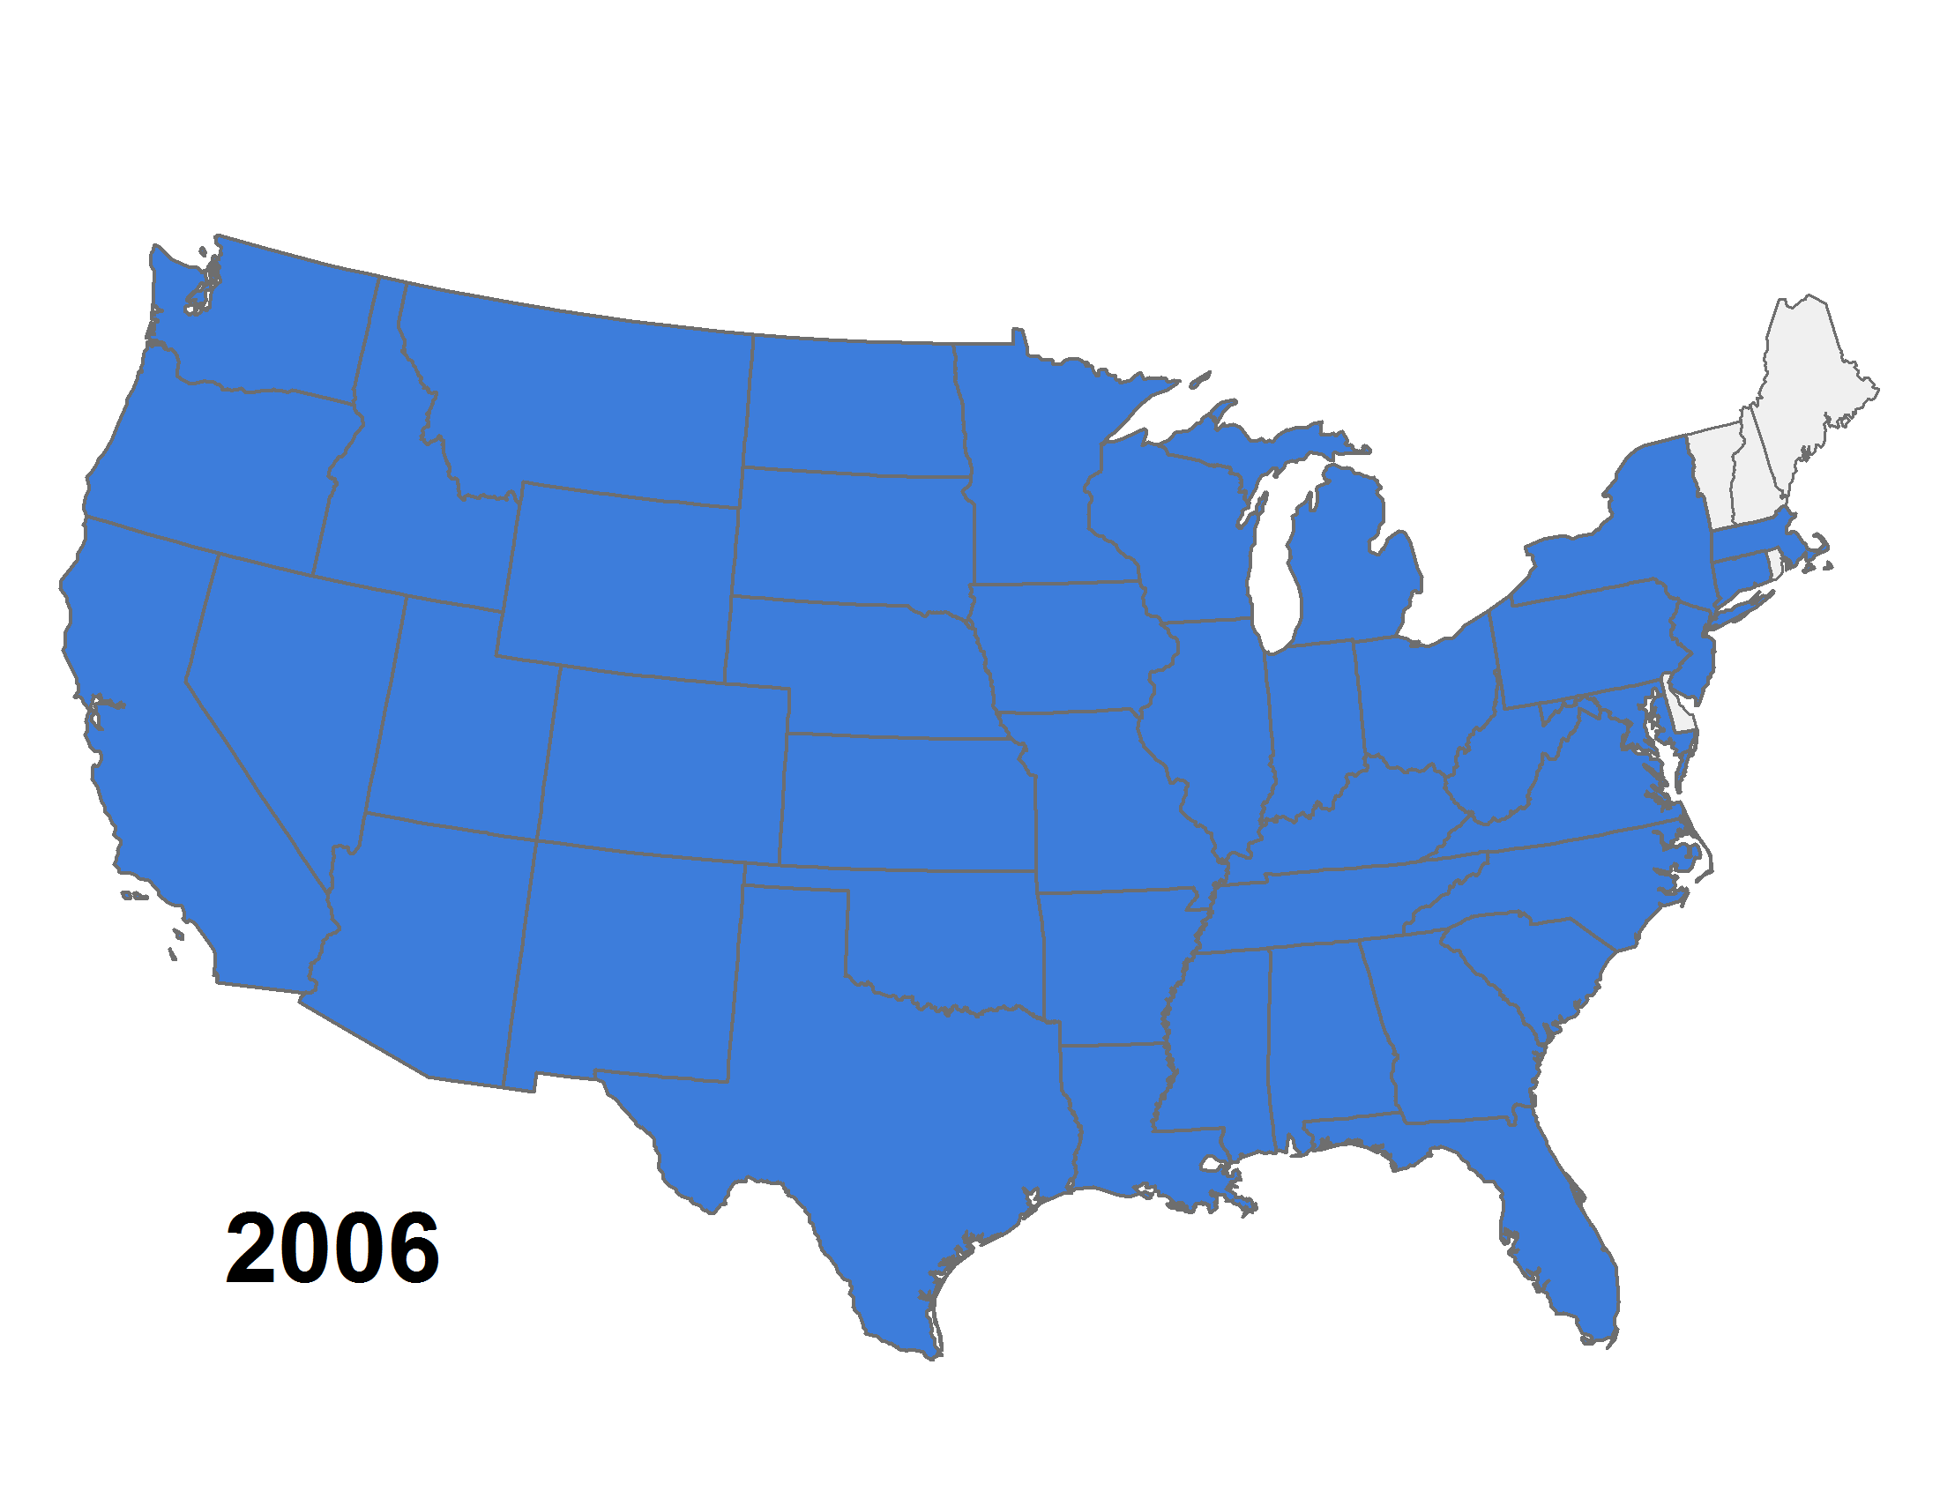
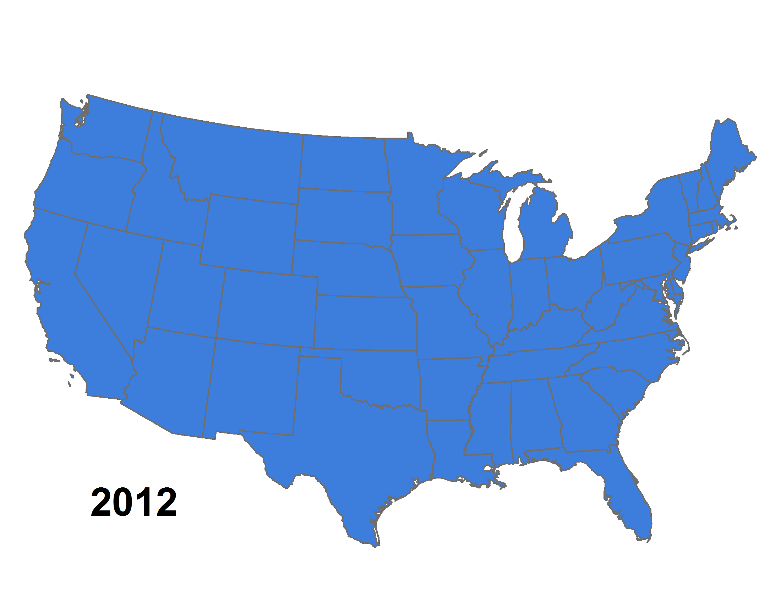
1
2
4
2
5
4
7
1
6
10
3
16
48
19
12
8
98
2
1
13
20
7
51
14
1
46
33
1
52
9
1
26
2
6
4
2
11
8
3
1
1
18
West Nile Virus
Disease Spread
Study Area Locations
Notes:
For another example, think of infectious disease. We can look at how knowledge spreads over time relative to other events like in the case of the spread of West Nile Virus in the US. We can see how knowledge of the disease tracks the disease itself over time.

Slide 13
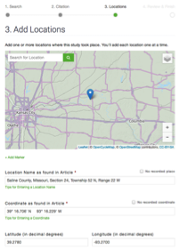
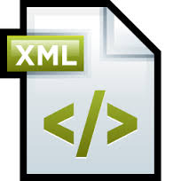

JournalMap Content Entry
NLM 3.0
Batch entry
Single-article
Geotagging Services, Review and Release
Automated coordinate geo-parsing engine (80+ formats and growing)
Semi-automated place name geo-parsing engine
Manual geotagging
Notes:
We get articles into JournalMap in several different ways including the ability to reading industry standard XML formats from publishers. Data refinement and approval are done directly on the website before any records go live on JournalMap. Latitude/longitude values of the actual study area locations are assigned using algorithms that detect and parse coordinates in text, or by semi-automated geoparsing of place names, or in some cases manual geotagging by our interns.

Slide 14
Our Vision:
Geotagged Literature
Map-based Searching
Partnerships
Large-scale article geotagging
Location-reporting standards
Encoding location in metadata/XML
API Development
Embeddable Searches/Results
Additional search Filters
Current
Taylor & Francis
IOP
Pensoft
Developing
USDA National Ag. Library
UNEPlive.org
ICRAF
Future
???
Applications
Discover relevant knowledge
Syntheses/Meta-studies
Understand processes
Evaluate Bias
Reduce redundancy
Notes:
Our vision for JournalMap is to see geographic-based literature discovery and analysis tools become commonplace. This includes not only large-scale geotagging of articles, but also working with publishers and societies to implement standards for reporting locations. Right now we working with a number of collaborators including Taylor & Francis, IOP, and Pensoft on geotagging journal archives and developing additional features and services. And we’re open to any additional inquiries or collaborations as we expand our efforts.

Slide 15
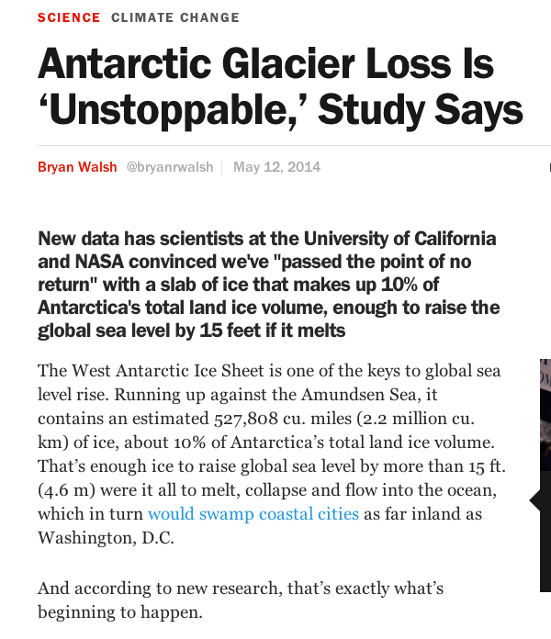
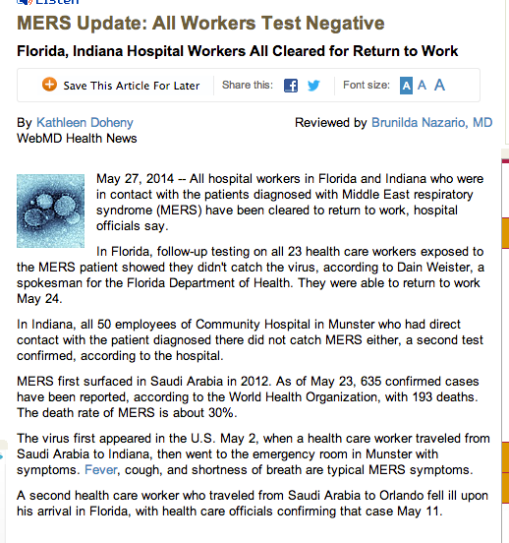
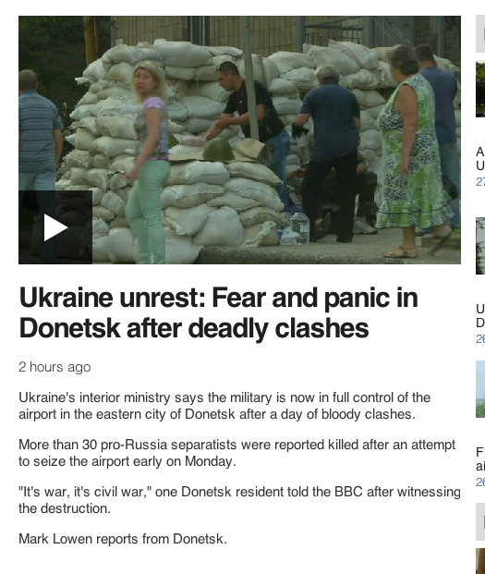
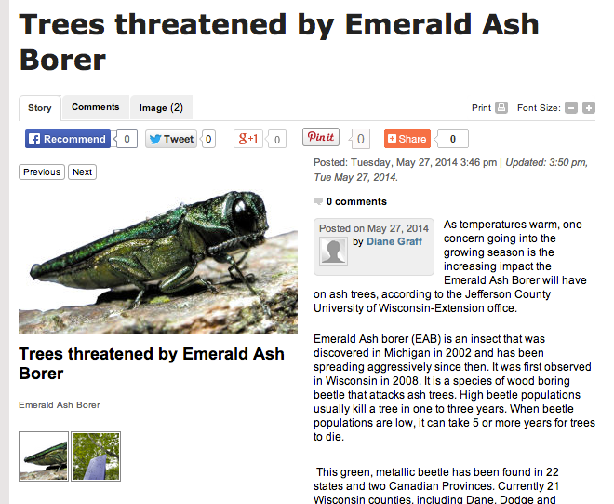
Location matters
for scholarly knowledge discovery
Notes:
Many of the pressing problems that we face in the world have some geographic component associated with them. Likewise, the scholarly knowledge that is derived in understanding these problems will also be tied to locations, and our ability to find and use that knowledge will depend in part on that location-based context.

Slide 16

http://www.journalmap.org
Jason Karl, Ph.D.
USDA ARS, Jornada Experimental Range
Email: jason@journalmap.org Tel: (575)-646-1301
@JournalMap
Notes:
JournalMap provides a powerful new tool to researchers for augmenting scholarly literature searching. We would love the chance to talk to those in the publishing industry about how we can leverage location information that is hidden inside scientific papers to unlock new possibilities for knowledge discovery and application.

